Slide 1
Presentation Title
Subtitle or Date

Slide 2
Content
Content
M-ary tree and properties
Theorem got from tossing an unbiased coin.

Slide 3
Introduction
Introduction
This presentation will consider the problem of generating a series of Random Variables by tossing a M-sided coin.
Random number generation using an unbiased M-coin.

Slide 4
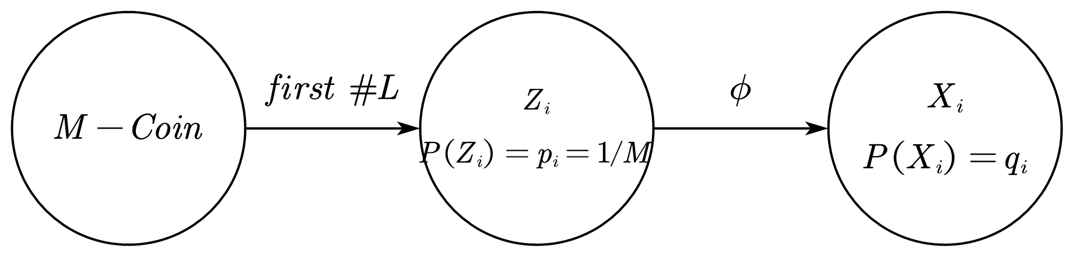
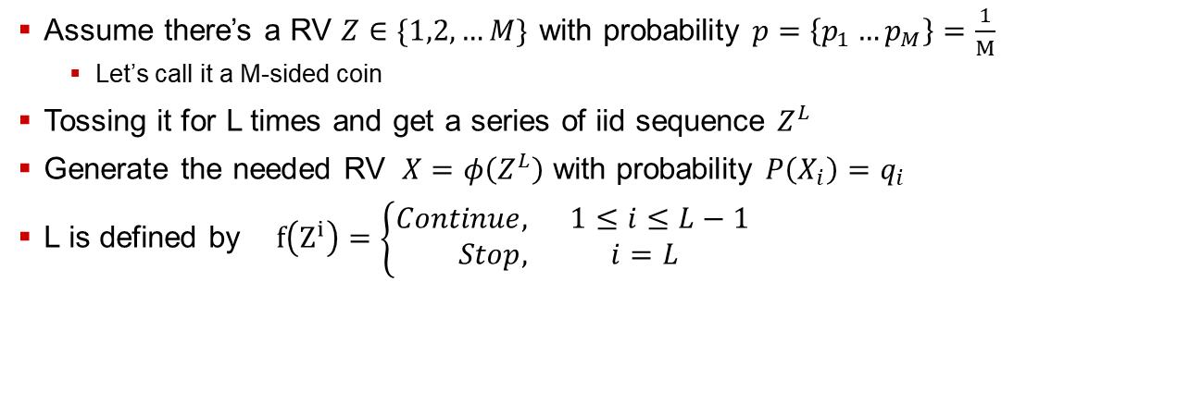
M-ary tree
M-ary tree
Assume there’s a RV $Z∈\{1,2,…M\}$ with probability $p=\left\{p_{1}…p_{M}\right\}=\frac{1}{M}$
Let’s call it a M-sided coin
Tossing it for L times and get a series of iid sequence $Z^{L}$
Generate the needed RV $X=φ\left(Z^{L}\right)$ with probability $P\left(X_{i}\right)=q_{i}$
L is defined by $f\left(Z^{i}\right)=\left\{\begin{aligned}Continue, 1≤i≤L−1 \\ Stop, i=L \end{aligned}\right.$

Slide 5

Properties
M-ary tree
Tree is complete, i.e., every node has M children.
Note the branches that connecting the parent node and all those child nodes as 1, 2, …, M from left to right;
Each leaf on the tree T is labeled with one of the values in $X=\{1,2,…,N\}$ (one label can be assigned to multiple leaves

Slide 6
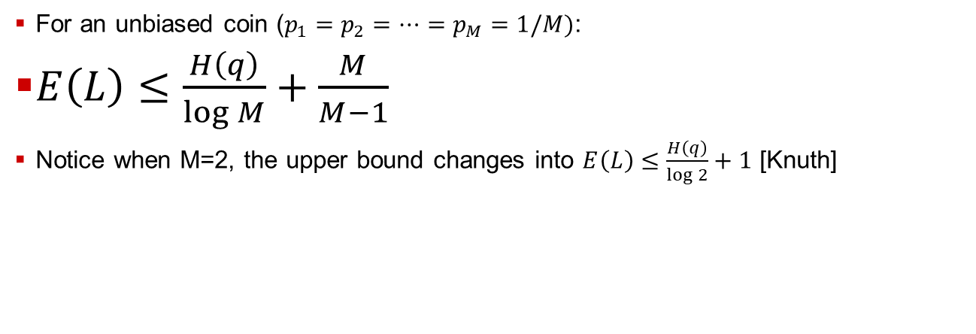
Theorem
Random number generation by an unbiased M-coin
For an unbiased coin ($p_{1}=p_{2}=…=p_{M}=1/M)$:
$E\left(L\right)≤\frac{H\left(q\right)}{\log{M}}+\frac{M}{M−1}$
Notice when M=2, the upper bound changes into $E\left(L\right)≤\frac{H\left(q\right)}{\log{2}}+1$ [Knuth]

Slide 7
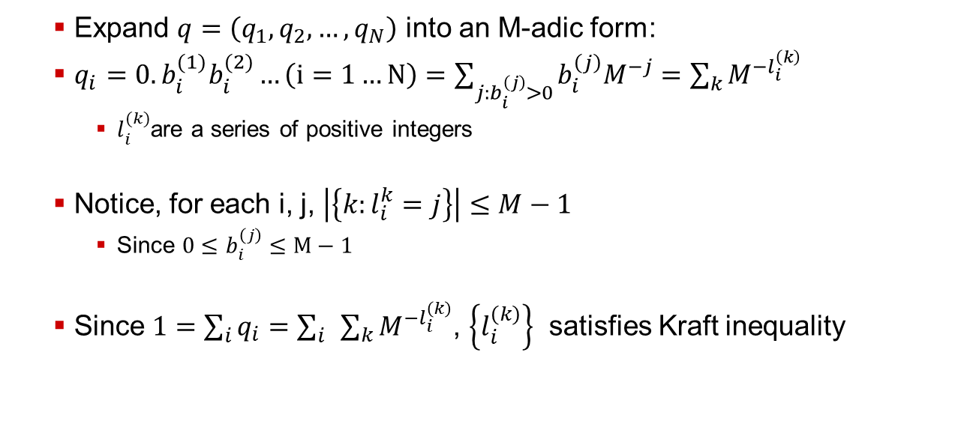
Proof
Expand $q=\left(q_{1},q_{2},…,q_{N}\right)$ into an M-adic form:
$q_{i}=0.b_{i}^{(1)}b_{i}^{(2)}…\left(i=1…N\right)=\sum_{j:b_{i}^{\left(j\right)}>0}{b_{i}^{\left(j\right)}M^{−j}}=\sum_{k}{M^{−l_{i}^{\left(k\right)}}}$
$l_{i}^{(k)}$are a series of positive integers
Notice, for each i, j, $\left|\left\{k:l_{i}^{k}=j\right\}\right|≤M−1$
Since $0≤b_{i}^{\left(j\right)}≤M−1$
Since $1=\sum_{i}{q_{i}}=\sum_{i}{ }\sum_{k}{M^{{−l}_{i}^{\left(k\right)}}}$, $\left\{l_{i}^{\left(k\right)}\right\}$ satisfies Kraft inequality

Slide 8
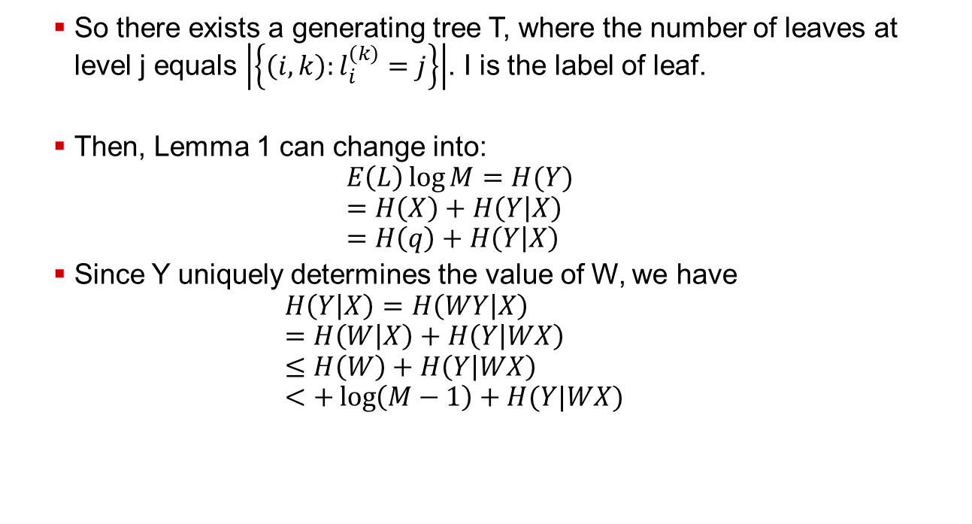
Proof
So there exists a generating tree T, where the number of leaves at level j equals $\left|\left\{\left(i,k\right):l_{i}^{\left(k\right)}=j\right\}\right|$. I is the label of leaf.
Then, Lemma 1 can change into: $E\left(L\right)\log{M=H(Y)}$ $=H\left(X\right)+H\left(Y | X\right)$ $=H\left(q\right)+H\left(Y | X\right)$
Since Y uniquely determines the value of W, we have $H\left(Y | X\right)=H\left(WY | X\right)$ $=H\left(W | X\right)+H\left(Y | WX\right)$ $≤H\left(W\right)+H\left(Y | WX\right)$ $<+\log\left(M−1\right)+H(Y|WX)$

Slide 9
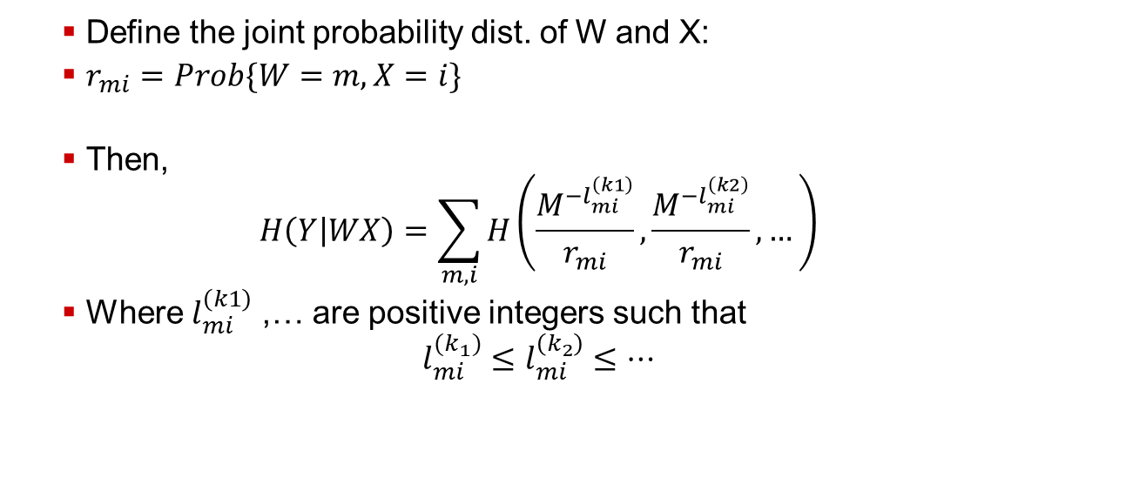
Proof
Define the joint probability dist. of W and X:
$r_{mi}=Prob\{W=m, X=i\}$
Then, $H\left(Y | WX\right)=\sum_{m,i}{H\left(\frac{M^{−l_{mi}^{\left(k1\right)}}}{r_{mi}},\frac{M^{−l_{mi}^{\left(k2\right)}}}{r_{mi}},…\right)}$
Where $l_{mi}^{\left(k1\right)}$ ,… are positive integers such that $l_{mi}^{{(k}_{1})}≤l_{mi}^{\left(k_{2}\right)}≤…$

Slide 10
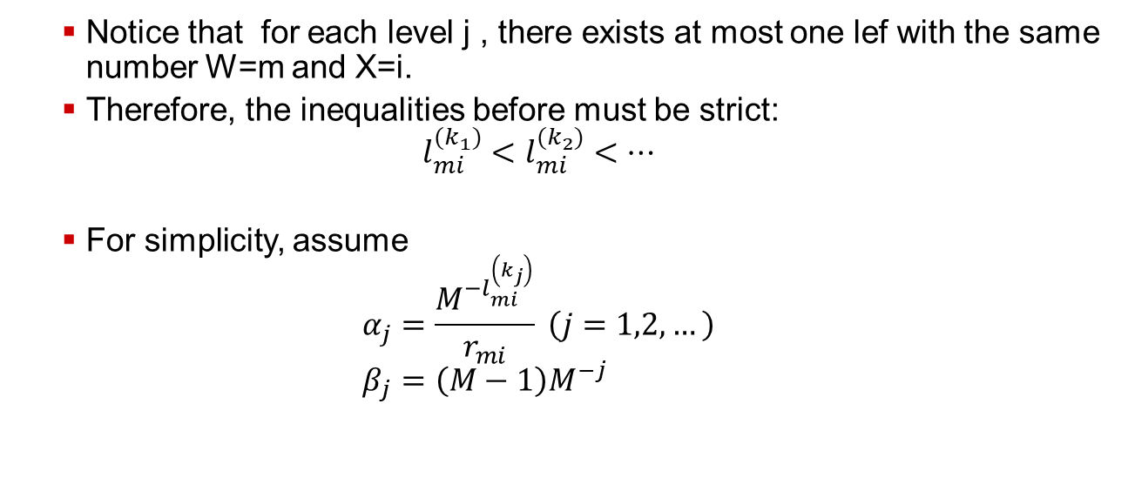
Proof
Notice that for each level j , there exists at most one lef with the same number W=m and X=i.
Therefore, the inequalities before must be strict: $l_{mi}^{{(k}_{1})}<l_{mi}^{{(k}_{2})}<…$
For simplicity, assume $α_{j}=\frac{M^{−l_{mi}^{\left(k_{j}\right)}}}{r_{mi}} \left(j=1,2,…\right)$ $β_{j}=\left(M−1\right)M^{−j}$

Slide 11
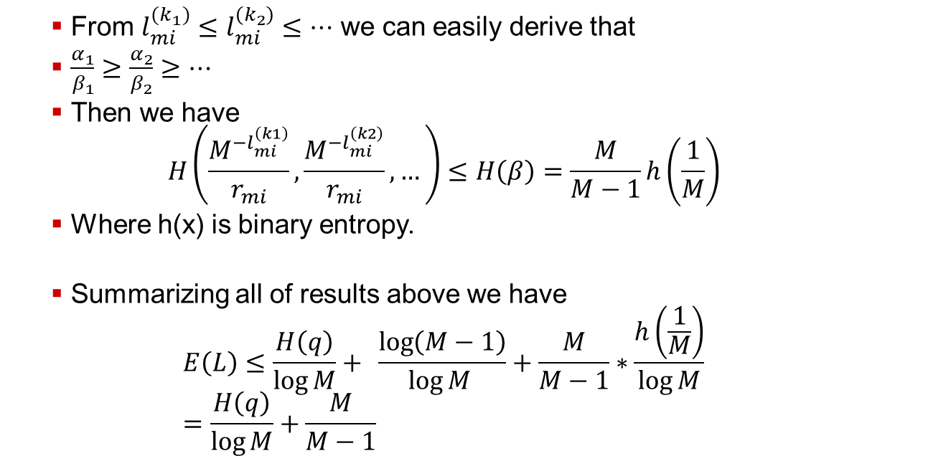
Proof
From $l_{mi}^{{(k}_{1})}≤l_{mi}^{\left(k_{2}\right)}≤…$ we can easily derive that
$\frac{α_{1}}{β_{1}}≥\frac{α_{2}}{β_{2}}≥…$
Then we have $H\left(\frac{M^{−l_{mi}^{\left(k1\right)}}}{r_{mi}},\frac{M^{−l_{mi}^{\left(k2\right)}}}{r_{mi}},…\right)≤H\left(β\right)=\frac{M}{M−1}h\left(\frac{1}{M}\right)$
Where h(x) is binary entropy.
Summarizing all of results above we have $E\left(L\right)≤\frac{H\left(q\right)}{\log{M}}+{\frac{\log\left(M−1\right)}{\log{M }}}+\frac{M}{M−1}∗\frac{h\left(\frac{1}{M}\right)}{\log{M}}$ $=\frac{H\left(q\right)}{\log{M}}+\frac{M}{M−1}$

Slide 12
Proof
Expand $q=\left(q_{1},q_{2},…,q_{N}\right)$ into an M-adic form:
$q_{i}=0.b_{i}^{(1)}b_{i}^{(2)}…\left(i=1…N\right)=\sum_{j:b_{i}^{\left(j\right)}>0}{b_{i}^{\left(j\right)}M^{−j}}=\sum_{k}{M^{−l_{i}^{\left(k\right)}}}$
$l_{i}^{(k)}$are a series of positive integers
Notice, for each i, j, $\left|\left\{k:l_{i}^{k}=j\right\}\right|≤M−1$
Since $0≤b_{i}^{\left(j\right)}≤M−1$
Since $1=\sum_{i}{q_{i}}=\sum_{i}{ }\sum_{k}{M^{{−l}_{i}^{\left(k\right)}}}$, $\left\{l_{i}^{\left(k\right)}\right\}$ satisfies Kraft inequality

Slide 13
Proof
Expand $q=\left(q_{1},q_{2},…,q_{N}\right)$ into an M-adic form:
$q_{i}=0.b_{i}^{(1)}b_{i}^{(2)}…\left(i=1…N\right)=\sum_{j:b_{i}^{\left(j\right)}>0}{b_{i}^{\left(j\right)}M^{−j}}=\sum_{k}{M^{−l_{i}^{\left(k\right)}}}$
$l_{i}^{(k)}$are a series of positive integers
Notice, for each i, j, $\left|\left\{k:l_{i}^{k}=j\right\}\right|≤M−1$
Since $0≤b_{i}^{\left(j\right)}≤M−1$
Since $1=\sum_{i}{q_{i}}=\sum_{i}{ }\sum_{k}{M^{{−l}_{i}^{\left(k\right)}}}$, $\left\{l_{i}^{\left(k\right)}\right\}$ satisfies Kraft inequality

Slide 14
Proof
Expand $q=\left(q_{1},q_{2},…,q_{N}\right)$ into an M-adic form:
$q_{i}=0.b_{i}^{(1)}b_{i}^{(2)}…\left(i=1…N\right)=\sum_{j:b_{i}^{\left(j\right)}>0}{b_{i}^{\left(j\right)}M^{−j}}=\sum_{k}{M^{−l_{i}^{\left(k\right)}}}$
$l_{i}^{(k)}$are a series of positive integers
Notice, for each i, j, $\left|\left\{k:l_{i}^{k}=j\right\}\right|≤M−1$
Since $0≤b_{i}^{\left(j\right)}≤M−1$
Since $1=\sum_{i}{q_{i}}=\sum_{i}{ }\sum_{k}{M^{{−l}_{i}^{\left(k\right)}}}$, $\left\{l_{i}^{\left(k\right)}\right\}$ satisfies Kraft inequality

Slide 15
Proof
Expand $q=\left(q_{1},q_{2},…,q_{N}\right)$ into an M-adic form:
$q_{i}=0.b_{i}^{(1)}b_{i}^{(2)}…\left(i=1…N\right)=\sum_{j:b_{i}^{\left(j\right)}>0}{b_{i}^{\left(j\right)}M^{−j}}=\sum_{k}{M^{−l_{i}^{\left(k\right)}}}$
$l_{i}^{(k)}$are a series of positive integers
Notice, for each i, j, $\left|\left\{k:l_{i}^{k}=j\right\}\right|≤M−1$
Since $0≤b_{i}^{\left(j\right)}≤M−1$
Since $1=\sum_{i}{q_{i}}=\sum_{i}{ }\sum_{k}{M^{{−l}_{i}^{\left(k\right)}}}$, $\left\{l_{i}^{\left(k\right)}\right\}$ satisfies Kraft inequality

